Slide 1
Exploring Capability-based security in software design with Rust
Kenneth Fossen
June 13th, 2022
Notes:
Hello
My name is Kenneth Fossen, I have a bachelor's in Datatryggleik and have now been studying for a master's in Software engineering.
I'm going to present my master thesis "Exploring Capability-based security in software design with Rust".

Slide 2
Access Control and Today’s Security landscape
Notes:
We will start with some motivation for the importance of access control and some insight to today’s security landscape regarding access control.

Slide 3
Access Control
Critical in software design
Responsible for securing our data
Four models
«It is defining how users can interact with data in our applications»
Privacy
Notes:
They are crucial for how we design our software and are responsible for securing access to our data in our applications.
We have four access control models, they are ACL, RBAC, ABAC and CBAC.
These four models define how we can interact with data in our application.
And if is following GDPR Privacy.
Definition: “Access control enforces policy such that users cannot act outside of their intended permissions”

Slide 4

OWASP
What is OWASP?
Their work
Top10
Analysis
Image: https://owasp.org/Top10/
Notes:
OWASP - Open Web Application Security Project
It is a non-profit organization that has been the last 20 years publishing articles, documentation, and tools for web application security.
They are collecting data from partner organizations, and have collected data for 500,000 applications.
Their Top10, the product of their analysis which is a categorization of security problems and explanations of how to mitigate these problems is considered an industry standard.
This is why we care about OWASPs findings
In this round, they did a different approach for analyzing data., instead of asking for data for specific CWE. Common Weakness Enumerations They asked for any CWE and then did an analysis of the data,
and this has led to some new categories and a big update of their Top10.

Slide 5
Important Categories
Insecure Design
Security Misconfiguration
Identification and Authentication Failures
Broken Access Control

Slide 6
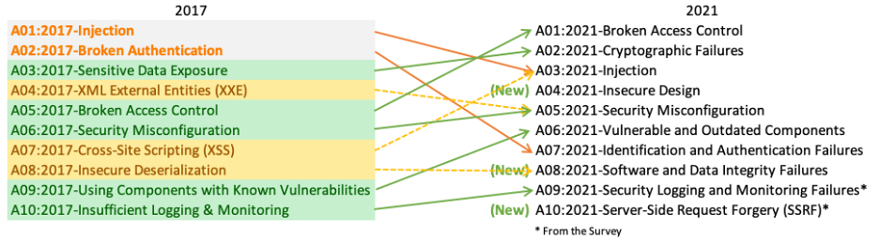
OWASP Top 10 Changes
Source: https://owasp.org/Top10/#whats-changed-in-the-top-10-for-2021
Notes:
INSECURE Design: Insecure design is a broad category representing different weaknesses, expressed as “missing or ineffective control design.”
SECURITY MiSCONFIG: The server does not send security headers or directives, or they are not set to secure values
ID & Auth: Previously known as Broken Authentication, and covers such problems as Permits default, weak, or well-known passwords,

Slide 7
A01:2021 – Broken Access Control
Numbers from OWASP:
94% broken access control
Root causes:
Cross-Site Request Forgery «Confused Deputy»
Violation of the principle of least privilege - PoLP
Elevation of privilege
Source: https://owasp.org/Top10/A01_2021-Broken_Access_Control/
Notes:
From their data, 94% of the applications they analyzed had some form of broken access control
This is quite a lot.
And the root problems listed in this category are the following.

Slide 8

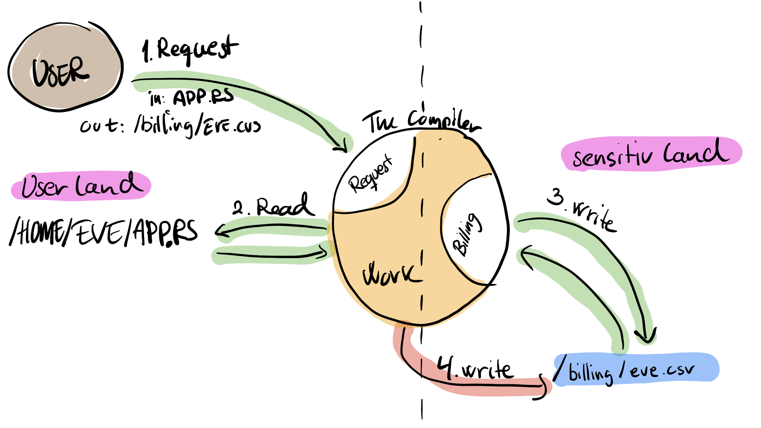
Confused Deputy
What is a confused deputy?
What can mitigate confused deputies?
Image: https://commons.wikimedia.org/wiki/File:Don_Knotts_Barney_and_the_bullet_Andy_Griffith_Show.jpg
Notes:
Confused deputy is best described when a user is interacting with another privileged process,
tricking the privileged process with valid input to overwrite sensitive information outside the user’s intended permissions,
Norm Hardy in 2003, wrote a paper named “Confused Deputy” where this term and example comes from.
This problem occurs because two principals act together: (1) the user with limited access and (2) the process with access to the sensitive
data.
Hardy’s example was in an operating system, writing to the filesystem, using ACL and was not able to mitigate this problem.
Arguing Capabilities are the way to go so solve this problem.
Capabilities are unforgeable tokens describing the authorization to access a resource for a principal.
Capabilities may be transferred between principals, and are eliminating this problem.

Slide 9
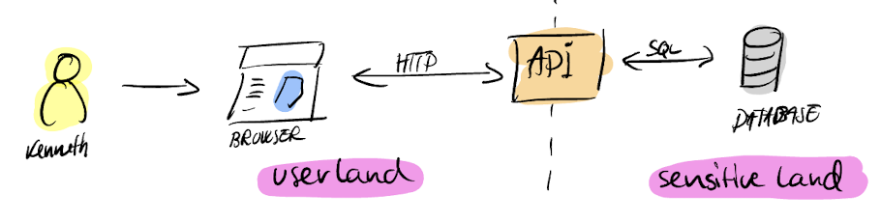
Web application architecture
RESTful API
CSRF
PoLP
Notes:
Web Application Architecture is similar to the example we described in Confused Deputy.
We usually have a browser that issues all our interactions to an API, usually a RESTful API.
RESTful stands for REPresentational State Transfer, and is a style of API that has been increasingly popular since 2005.
A RESTful API is built on top of HTTP protocol, making it easy to be interacted with from a web browser.
You can use the different HTTP GET, POST, or DELETE messages to fetch and manipulate data in the API.
The HTTP calls lets the API act as the business logic between us and the stored data in a database.
One of the constraints in a RESTful API design is statelessness.
Statelessness ensures that RESTful APIs are not designed to handle sessions state, e.g. authentication, making RESTful APIs prone to Cross-site request forgery (CSRF).
Also achieving the principal of least privilege can be really hard, you can restrict a lot for the user in the ”userland” but when the developer is interacting with data in the ”sensitiveland”
it is still prone to confused deputy problems.
You can try to use special patterns to get the Principle of Least Privilege to reduce the attack surface, but in most cases you will still have to access all the data in the database in some way.
Similarity with Browser – API and Confused Deputy

Slide 10
Motivation
OWASP - Broken Access Control
94% of 500 000 applications have some form of broken access control (OWASP)
Most access control is RBAC or ABAC
Almost no use of capability-based access control
Literature shows little or no use of capabilities in web applications
Notes:
Broken Access Control is a huge problem
94% have some form of broken access control
Most access control is RBAC or ABAC
ABAC is the recommended model now
Thee is almost no use of capability-based access control in modern web architecture.
Google Docs-, DropBox- sharing links

Slide 11
Goals

Slide 12
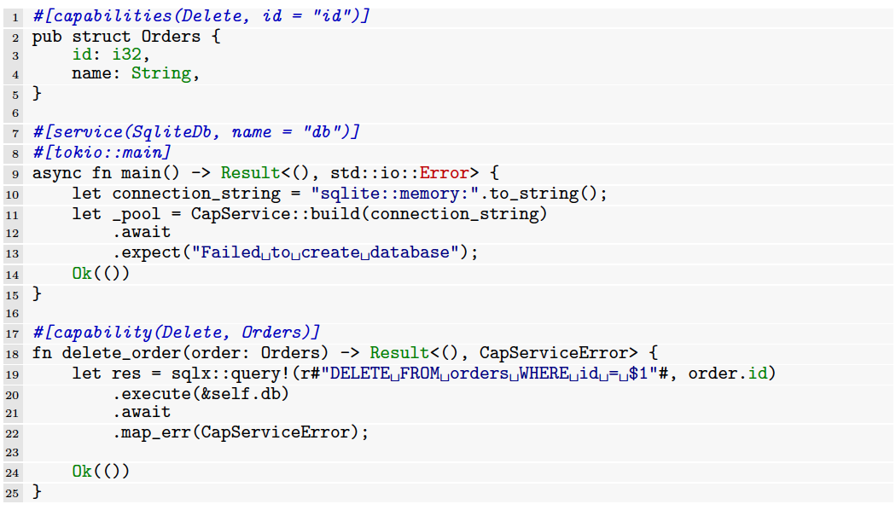
Goal: Capability Library
Find a software design for the API that gives us capability-based access control
Generalize this to a library

Slide 13
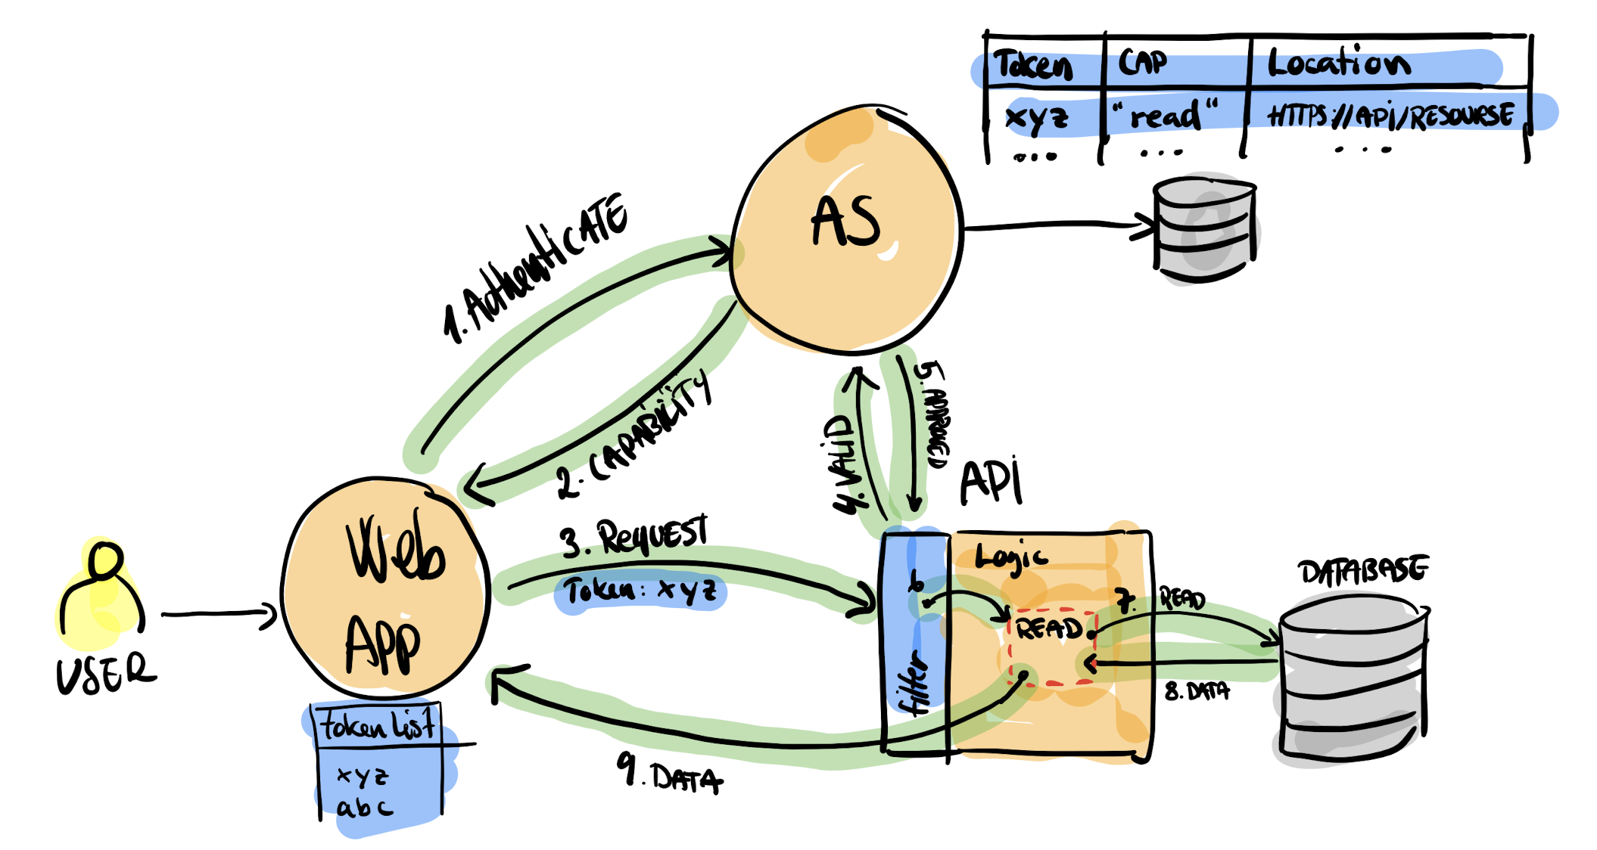
Goal: Capability System
Use this library together with a authorization server (AS)
Have a web app using AS to access our API

Slide 14
Confused Deputy & Capabilities
Notes:
Alright, let's talk some more about the Confused deputy and Capabilities

Slide 15
Confused Deputy
A privileged process that is tricked
Principle of Least Privilege (PoLP)
Does not solve, can reduce it

Slide 17
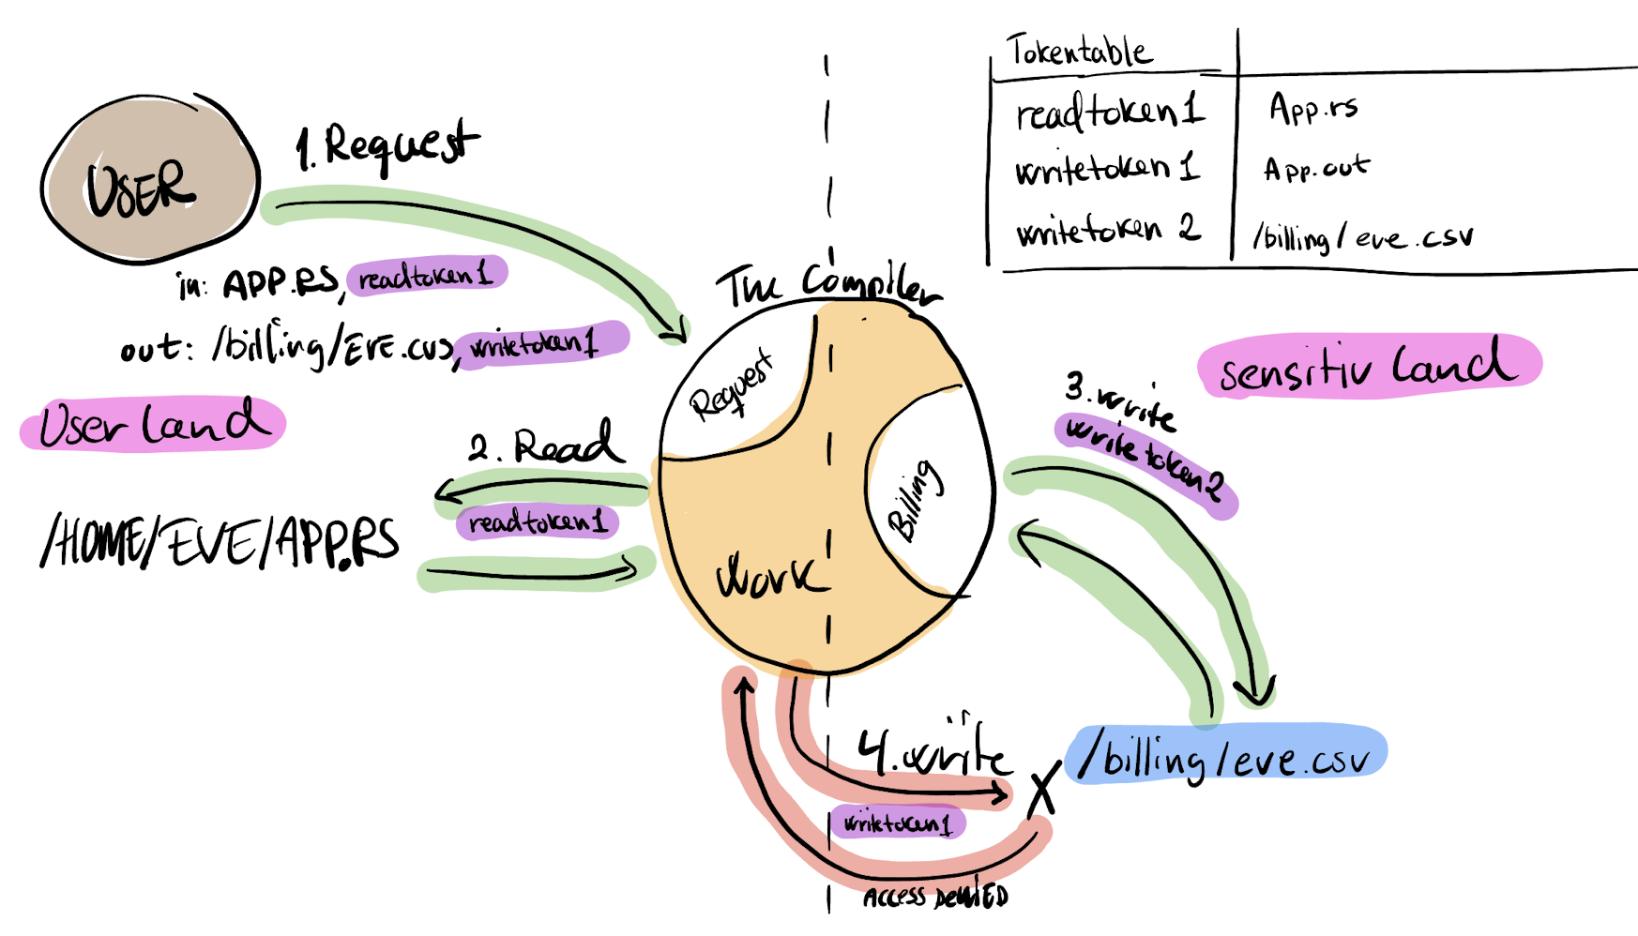

Slide 18
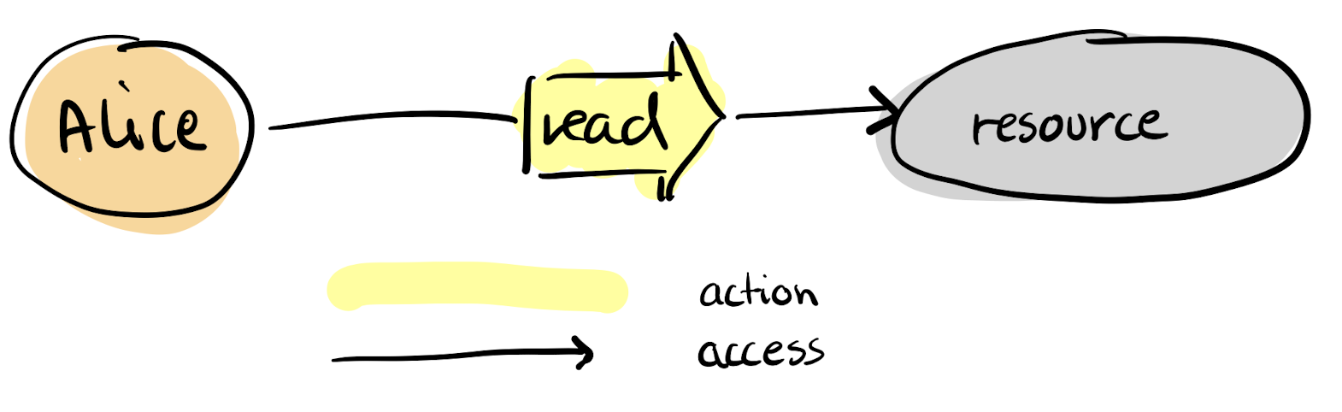
Capability Myths
Why are not capabilities used that much?
What are capabilities?
Keys «Token»
Delegate
Revokable
Composable
Notes:
What are capabilites:
They are sometimes described as keys to boxes that you can share,
but this is not entirely correct and has been the root of many misconceptions about capabilities.
They are an unforgeable reference to objects that gives access to objects/data, so it is sort of a «token» in Web Application world., e.g Alice has Read access to Resource.
A capability you can delegate (share), revoke and compose.
Millers paper Capabiliti Myths demolished.

Slide 19
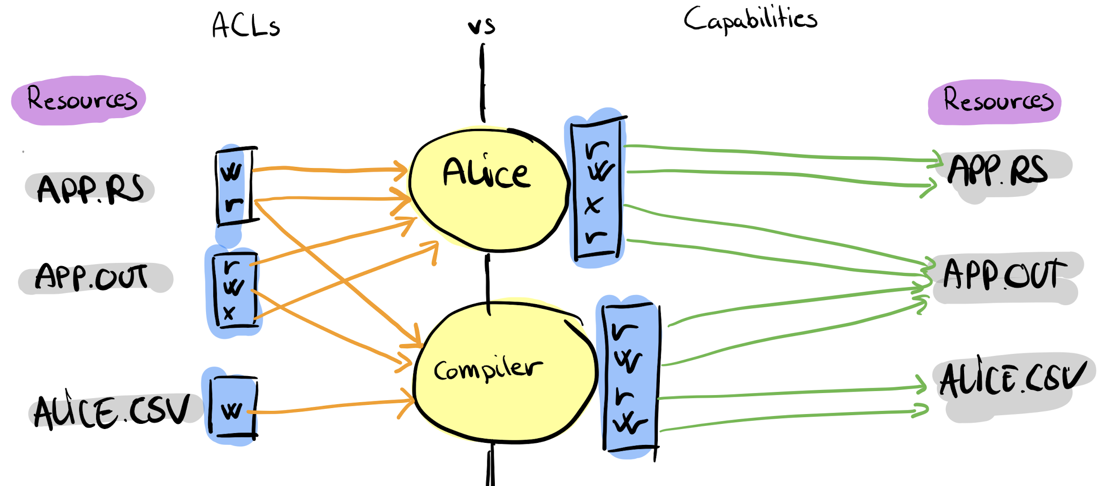
ACL vs Capabilities
Notes:
First myth is equivalence myth and it is about the belief that ACL and Capabilities are the same. Miller show this incorrect with this drawing, where we can se that for ACLs the arrows for the access rights are pointing to the identity subject.
And that in the capability system, the arrows are pointing from the subject to the resources.
So the difference is that in ACL, the write permission is on the Resource, and pointing to the subject (identity for ACL)
And for capabilities, the capabilities read, and execute for Alice is pointing to App.out and not the same way as ACLs.

Slide 20
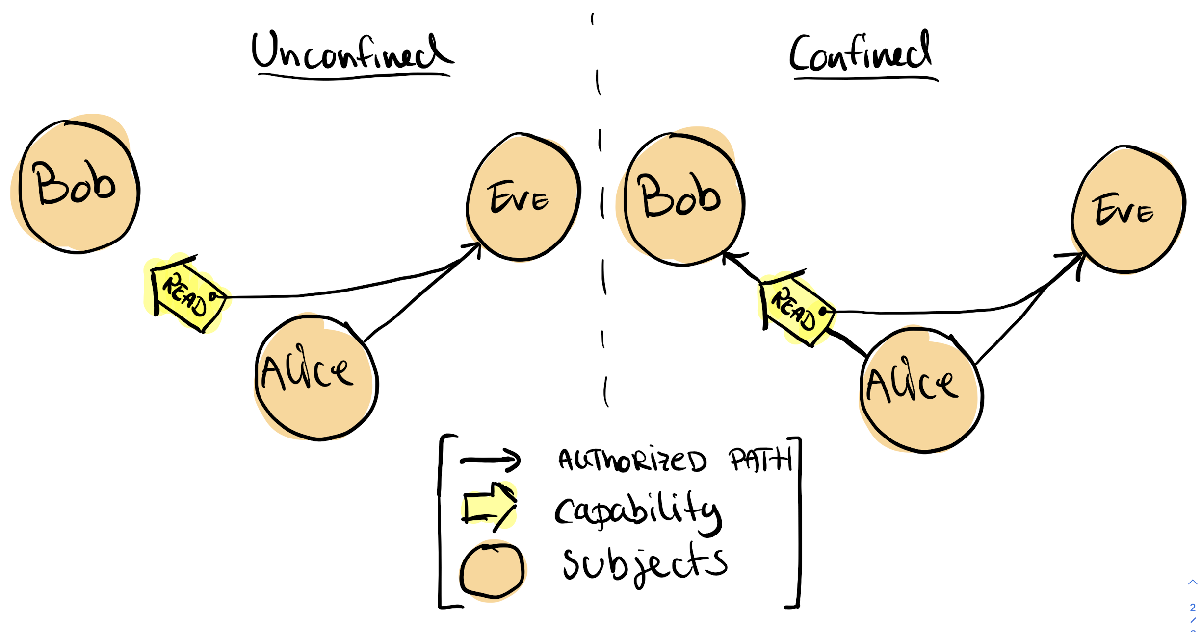
Confinement Myth
Notes:
Confinement myth is about with whom and how to share capabilities between subjects
in a capability-based system.
Trust is an important part of the capability system and we have to have an authorized path for both subjects to share a capability.
So the unconfined part cannot happen, Alice cannot delegate read to bob as she does not have an authorized path to bob.

Slide 21
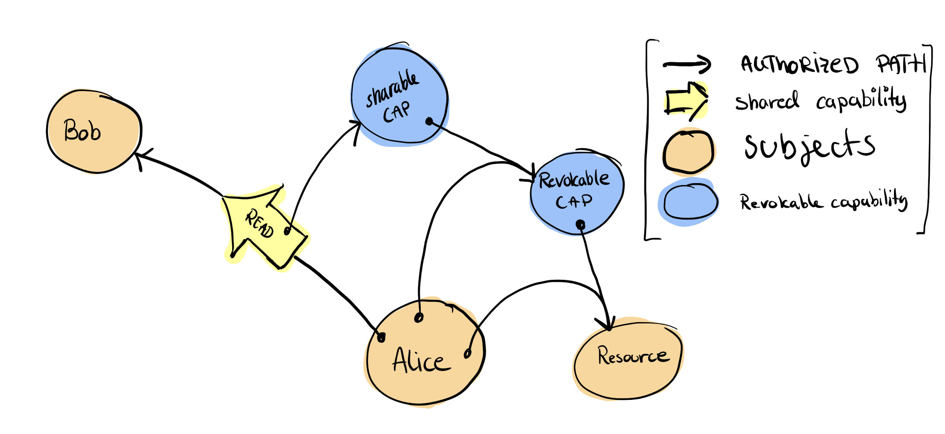
Irrevocability Myth
Notes:
The irrevocability myth is linked to the confinement myth and argues that one cannot
revoke access in a capability-based system when sharing a capability with a subject.
A capability is a reference with access privileges to a resource subject, and since the capabilities
are with the capability holder, one cannot revoke this capability from the holder.
Millers show this working with this example.
Here we share the read capability, which we can revoke throughout revokable capability,
And also maintain our private authorization path that ensures our reading of the data.

Slide 22
Capability System
Notes:
So to have a complete capability system, we need an authorization server that we can communicate and understand our capabilities.

Slide 23
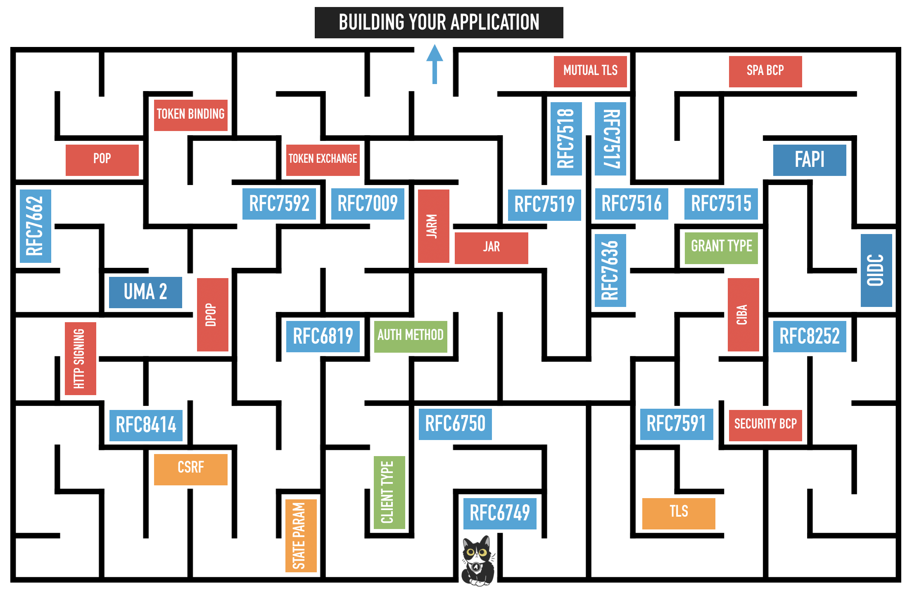
GNAP instead of OAuth
OAuth
GNAP
draft-ietf-gnap-core-protocol
draft-ietf-gnap-resource-servers
Source: https://aaronparecki.com/2019/12/12/21/its-time-for-oauth-2-dot-1

Slide 24
Experiments

Slide 25
Experiments 1a-c
Generic Type Parameters and Trait Bounds
Capability field inspired from TypeState
Using macros in Rust
Notes:
In the first part we looked at and tried some different designs.
1a. Gave a sense of capabilities when writing code, but it was prone to a lot of duplicate code and the developer did not have to adhere to the design, it could just circumvent it.
1b. Typestate, is a idea that you when you turn on a lightbulb, the option to turn it off is available. You cannot turn on a lightbulb that is already on. Using this code design, we tried, to get access attributes into the data structure. So if a object I only with READ, you can only read it, but this also.
1c. Macro we used is based Zack Mullaly’s discussion. The macro seem promising, we were able to compose several capabilities into a good design and use this to create an API with good structure.
But it required a lot of extra effort for the developer to adhere to the design, why should he do it?

Slide 26
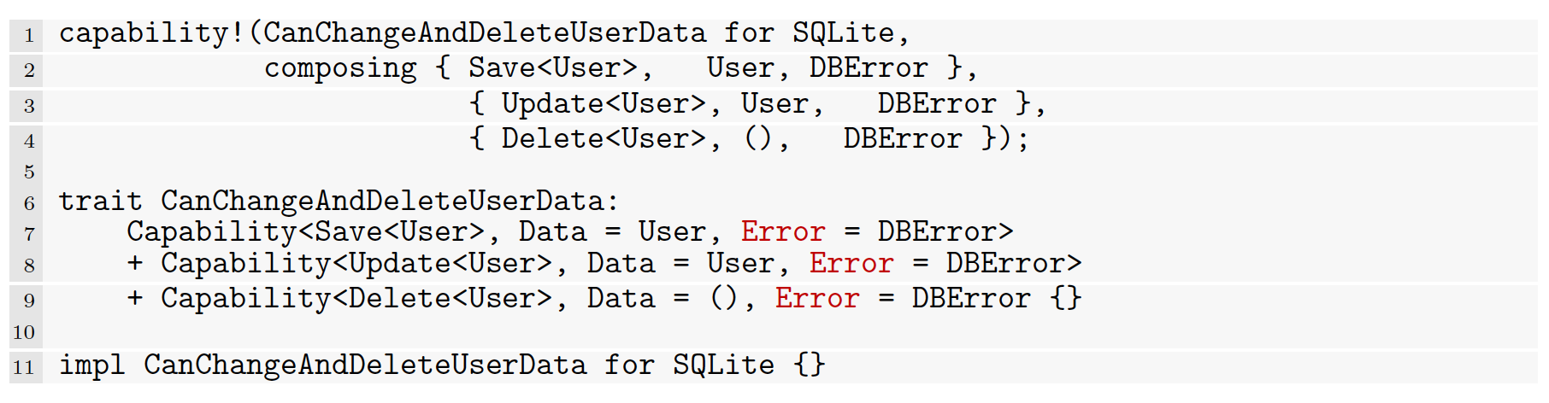
Example: CanChangeAndDeleteUserData

Slide 27
Experiments 2a-b
Creating a library that eases the developers work
Putting it together to a capability system

Slide 28
Library Use Example
Notes:
Resulting in this library using procedural macros.
On line 7, we define the Database engine we want to use for our capability service, and it acts as a wrapper for the system.
We then can for our data structure, connect it to with the Capabilities macro on line 1.
We list in this example only one Capability, Delete, but it can be a list of capabilities.
For each capability, we need to create a function that handles that operation, if not the compiler complains and will not compile our code.
We use the capability macro to link the Delete, Orders to the data structure.
Unfortunately I have not implemented any control over the input of the SQL query, so a developer can create a SQL query that creates data when it should delete.
Also, I believe the database should be supporting capabilities eliminating the need to parse the developer input.

Slide 29
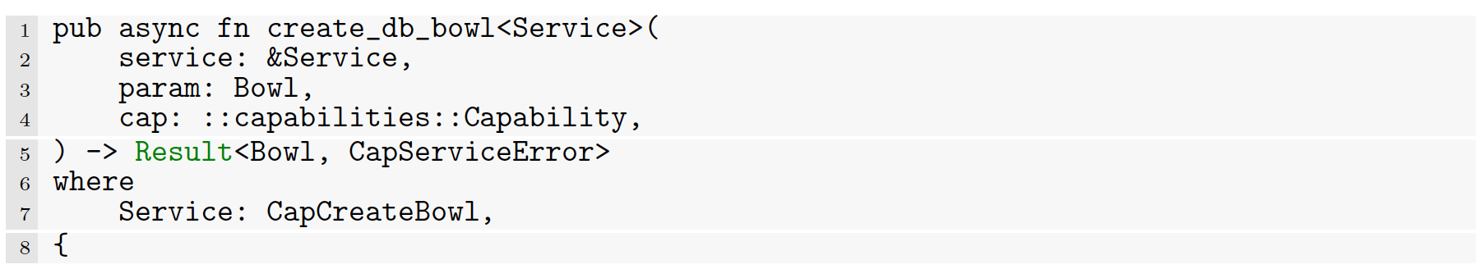
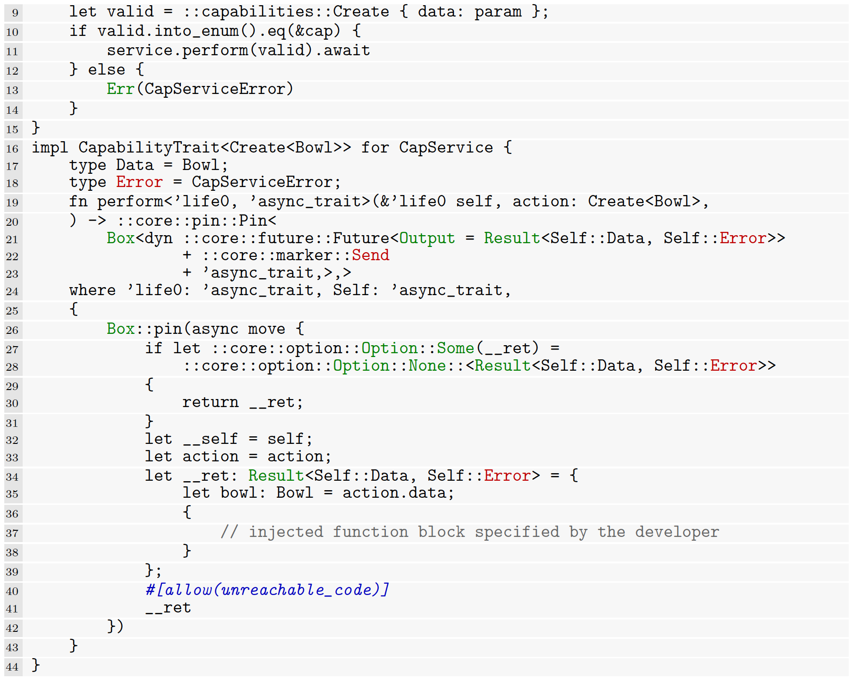
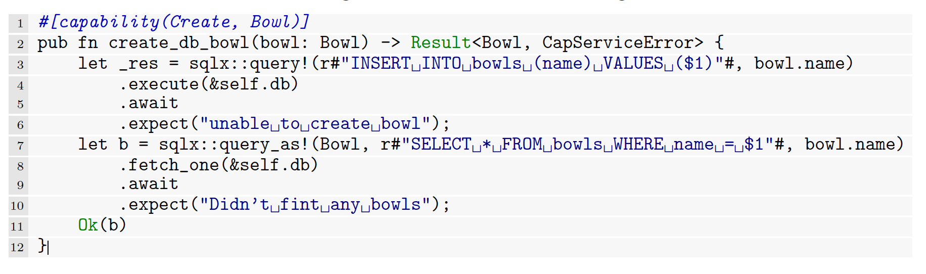
Library: Code generation
Notes:
Here is another example of the code we generate from the capability procedural macro.

Slide 30
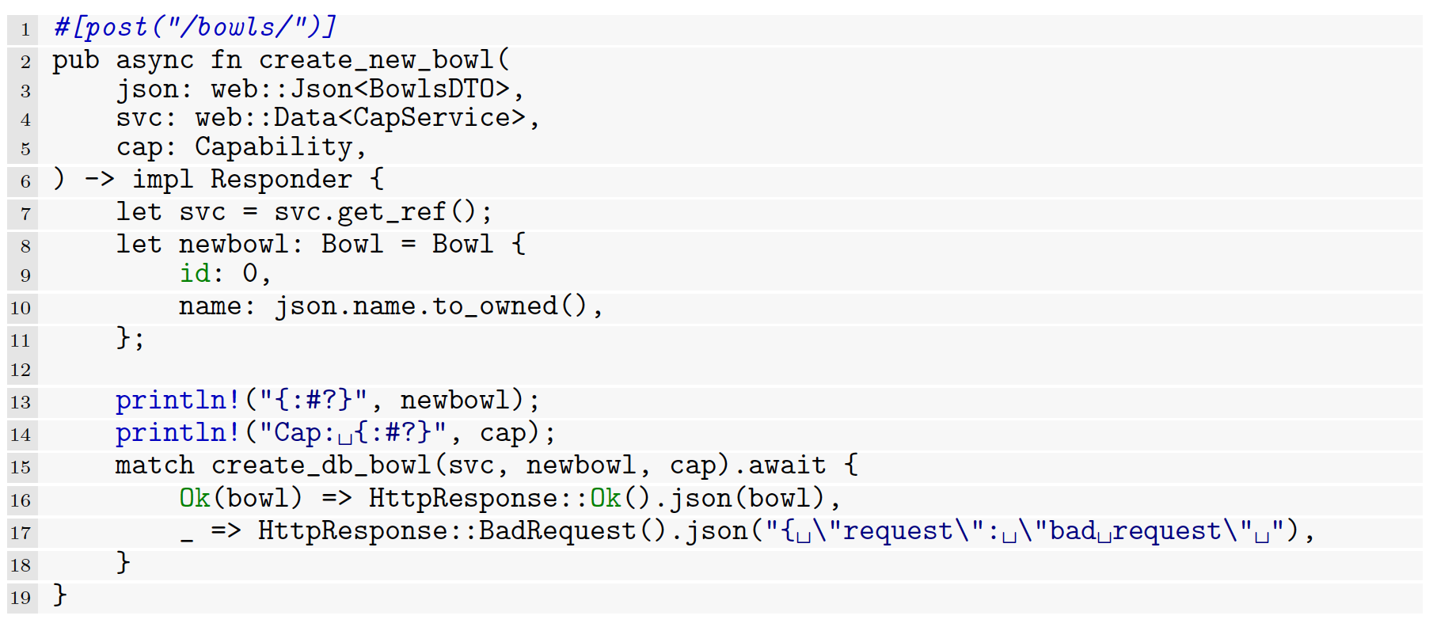
API Endpoint
Notes:
This is the API endpoint that the web app sends the requests.
It parses the capability and validates it, if it is valid this function will run,
then it will pass the capability to the match on line 15.
If you pass a Read for a Create it will fail and return.

Slide 31
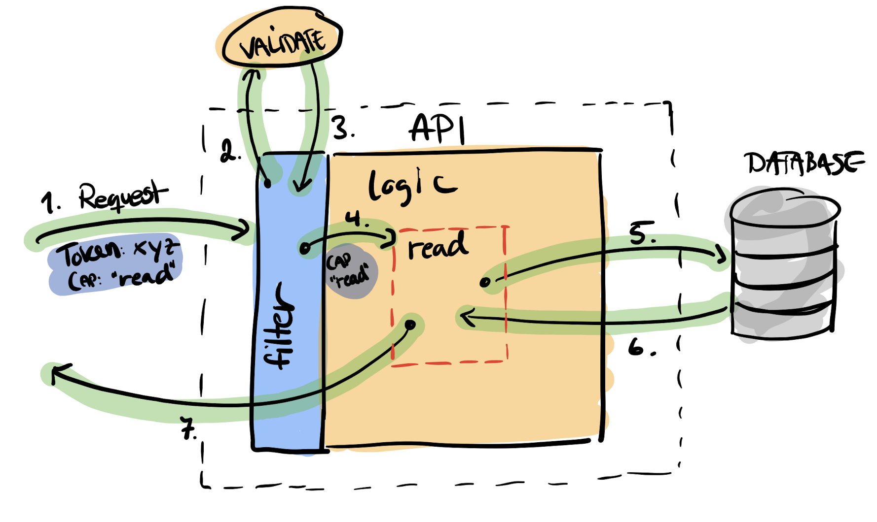
How it works
Notes:
Here is a visual step by step of the previous code snippets inside the API.

Slide 32
Capability System

Slide 33
Demo

Slide 34
Contribution

Slide 35
Results
Built the basis of a capability-based system
Created a library for developer
The confinement and delegation problem is not solved
Database
Notes:
We built the basis of a proof of concept capability-based access control system for web applications and showed it in use.
We have created a library so developers easily can develop and adhere to the design so we can reduce any confused deputy.
A capability can only run a specific function in the code.
This library is lacking some work especially when it comes to complex data models.
It’s far from perfect since the confinement and delegation problem is not solved.
It requires an extension of the GNAP protocol. Future work.
A crucial component that does not support capabilities, is the database.

Slide 36


Slide 37
Last page
uib.no

